Slide 1
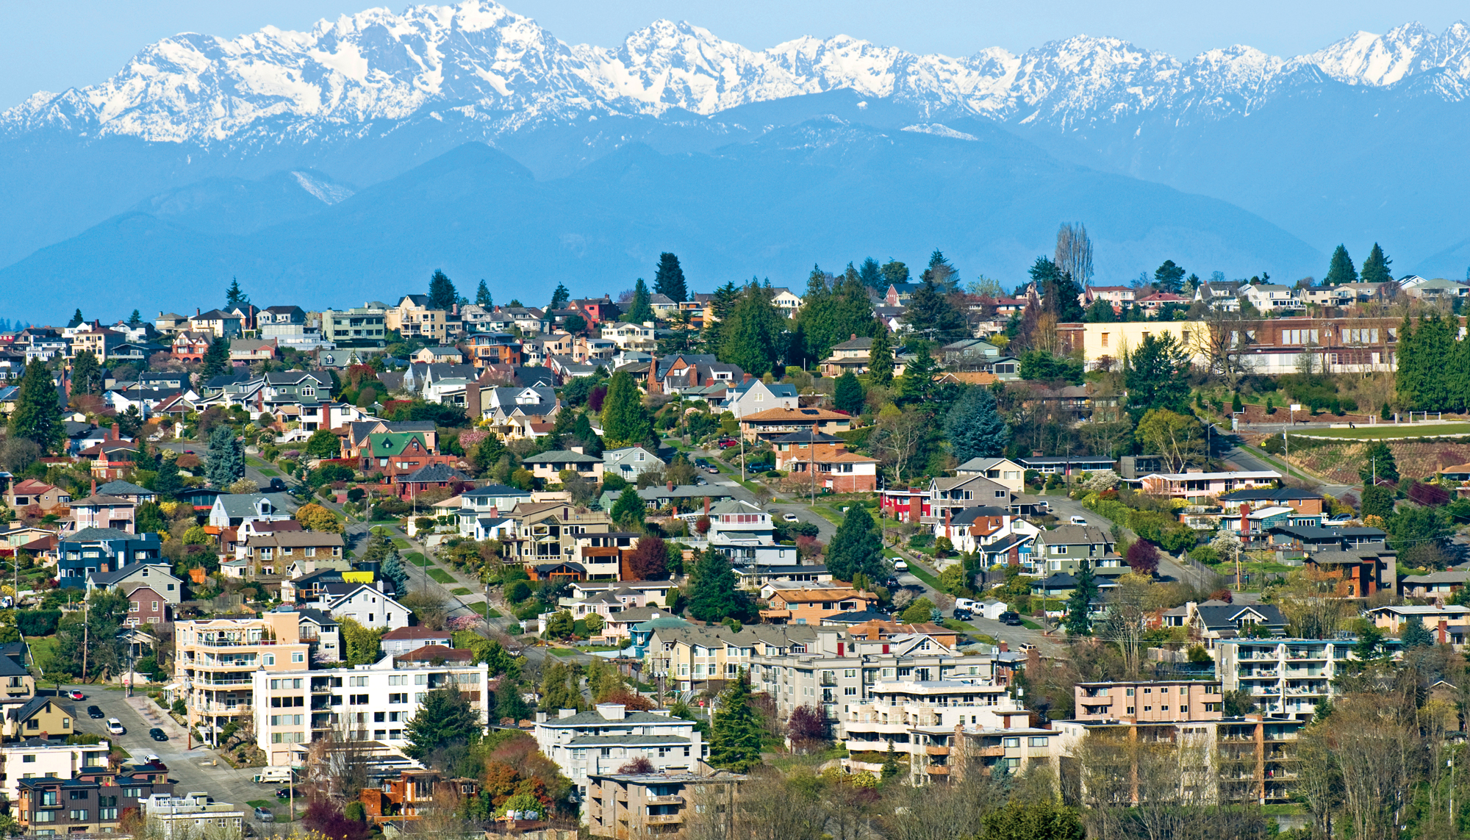
Housing Price Prediction
Kings County, Washington
Bobby Williams & Clair Marie Wholean

Slide 2
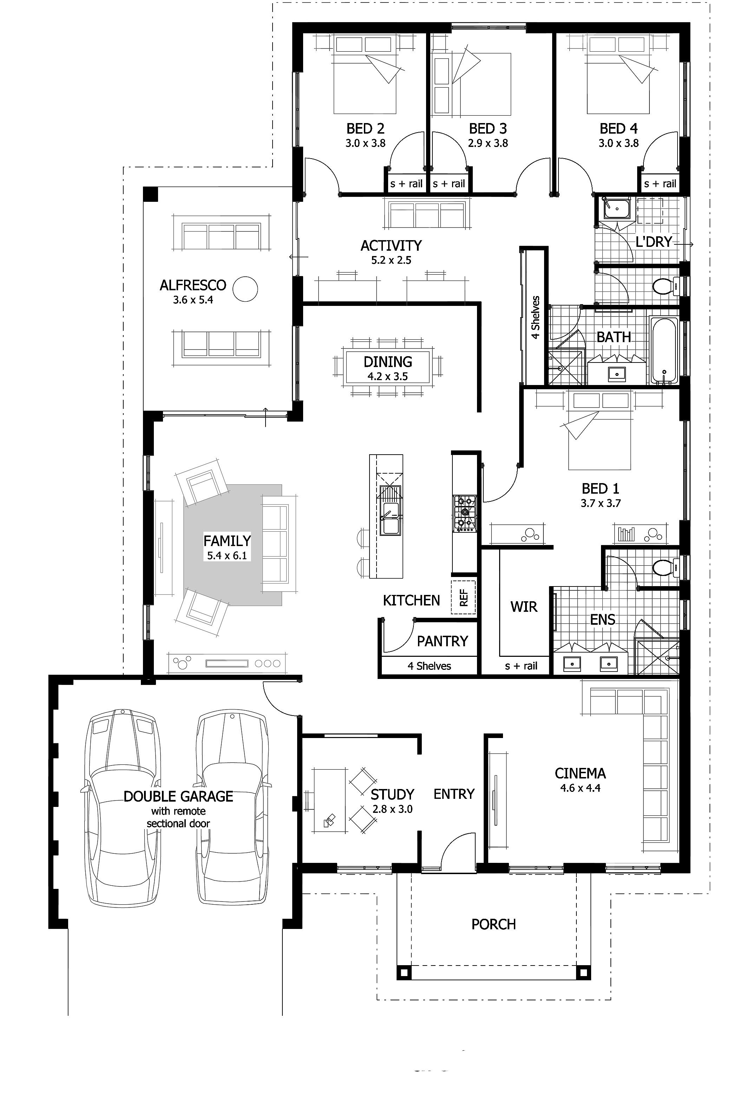
Key Questions
Which features predict the price of a home, and by how much?
Does density, as defined by the ratio of living area to lot area, affect house price?
Does a flat or sloping site affect the house price, and by how much?

Slide 3

Data & Assumptions
King County Housing Data Set
Single-family only
Location has a major impact on price, this study looks at other features.

Slide 4
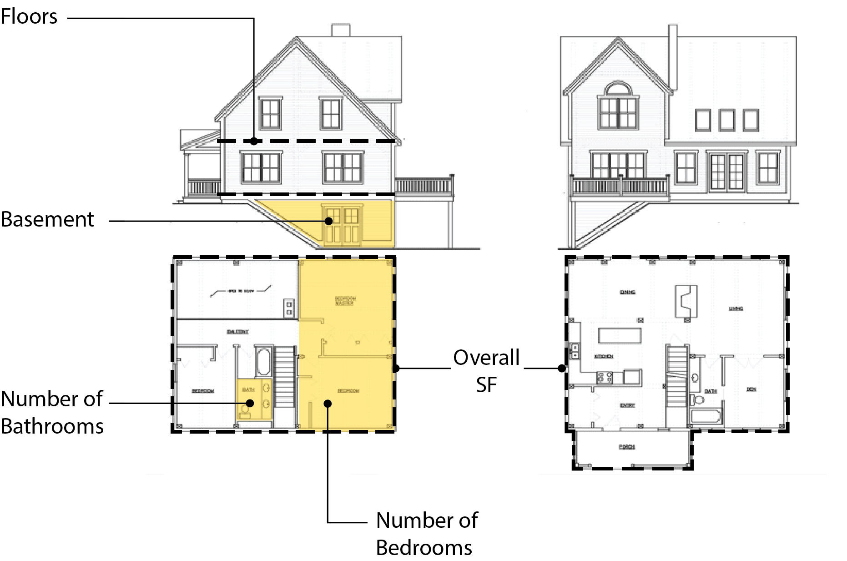
Variables Considered

Slide 5
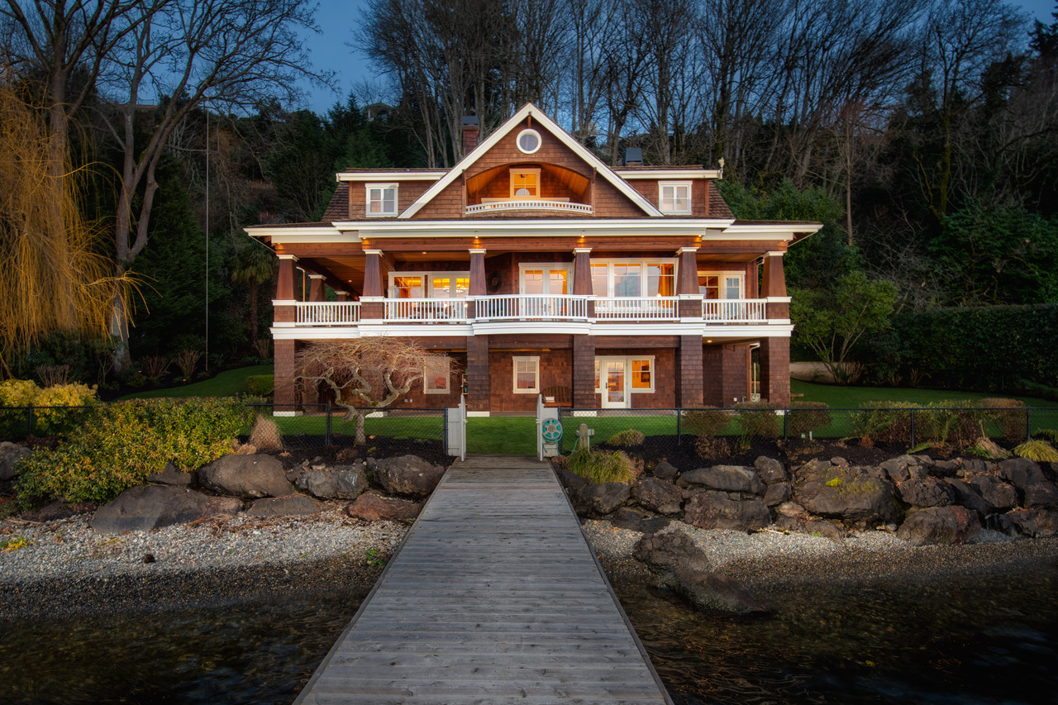
Waterfront Homes
A waterfront home is worth $814,000 more than a non-waterfront home.

Slide 6
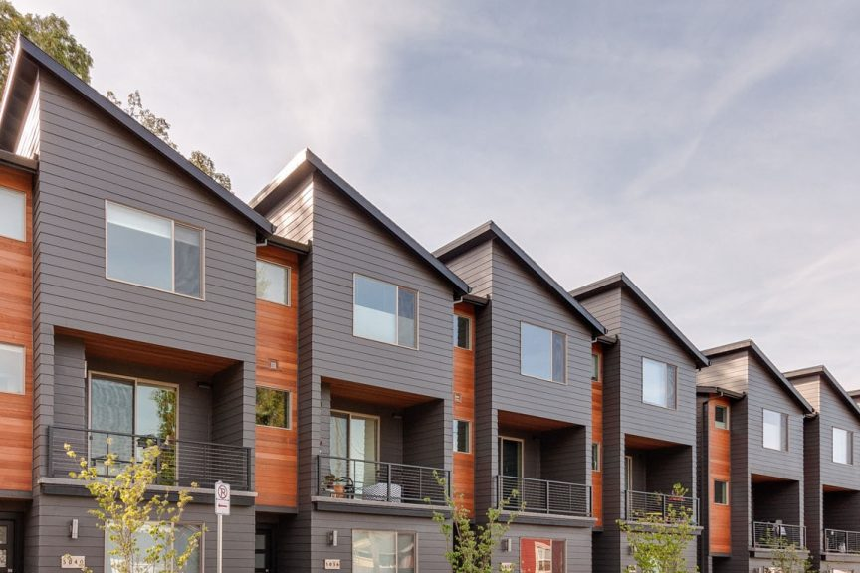
Urban vs. Non-urban
An urban home is worth $144,000 more than a non-urban home.

Slide 7
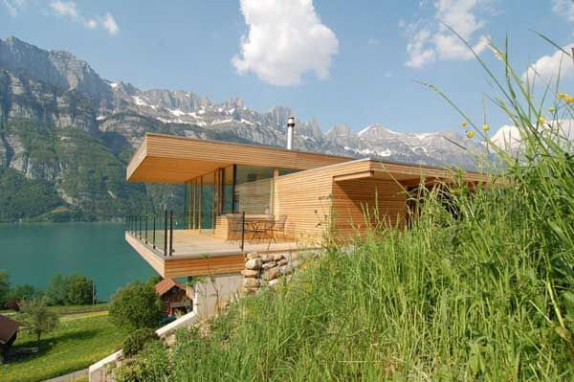
Homes on a Hill
Flat & Low-Slope, virtually no difference
Hilly, $194,000 more than flat/low slope
Steep, $1,078,000 more than flat/low slope

Slide 8
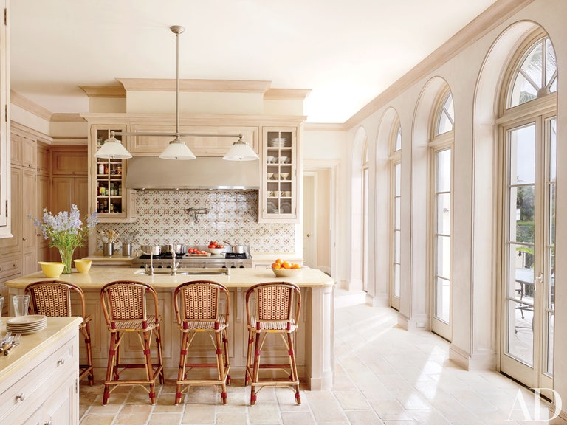
Recently Renovated
A recently renovated home is worth $153,000 more than a non-renovated home.
Recent defined as renovated after 2000.

Slide 9
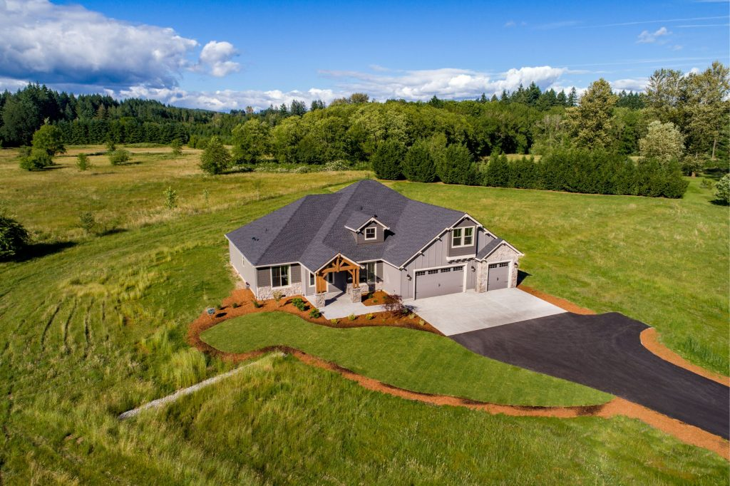
Lot Density
The ratio of total SF / lot SF.
Low density - baseline
Mid-density + $18,000
High Density + $119, 000

Slide 10
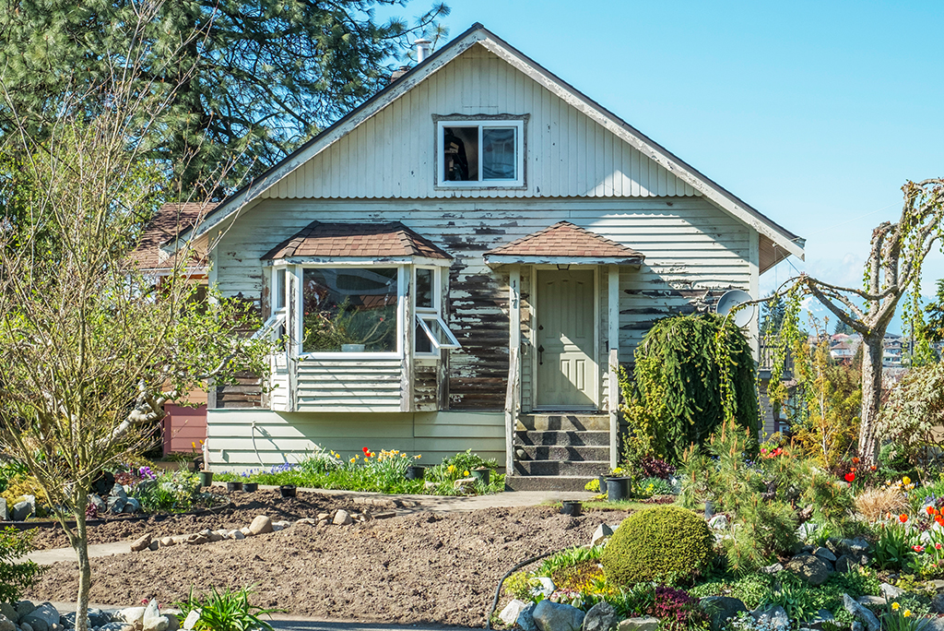
Overall Condition
Homes in good condition worth $36,700 more than homes needing repairs.

Slide 11




Overall SF
Lot SF
Bedrooms
Bathrooms
For each additional 100 SF, the house price goes up by $15,700.
For each 1,000 SF added to the lot, the price goes down $244
For each additional bedroom, the house price goes up by ?
For each additional bathroom, the house price goes up by 18,600

Slide 12


Floors
Basement SF
For each additional floor, the house price goes down by $43,400.
For each 1,000 SF of basement, the price goes up $69,600.

Slide 13
Predictions

Slide 14
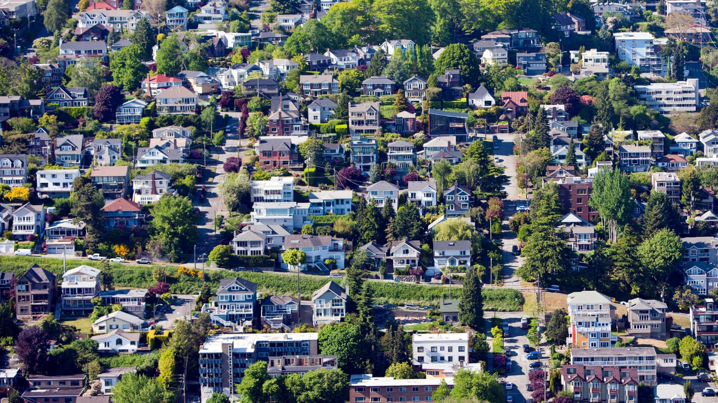
Further Study
Suburban homes
Predictions by zip code

